Slide 1
CS440/520 Artificial Intelligence
Computer Science Department
Lecture 3:
From Uninformed to Informed Search
9 September 2014
Instructor: Kostas Bekris

Slide 2
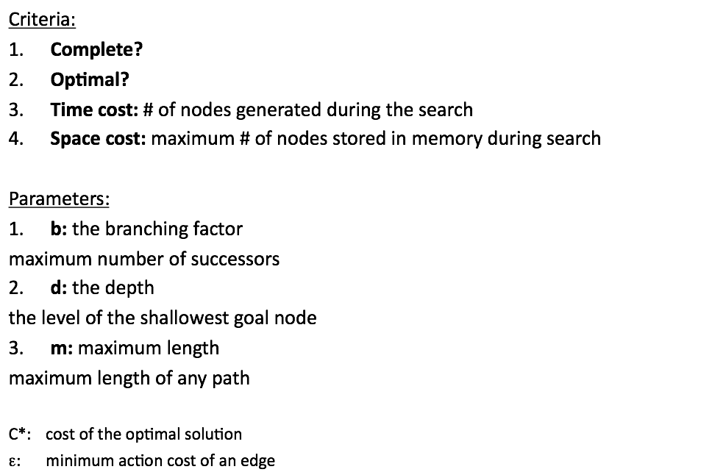
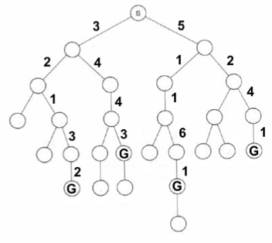

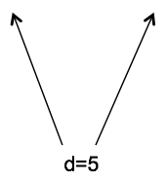


Comparing Search Strategies

Slide 3
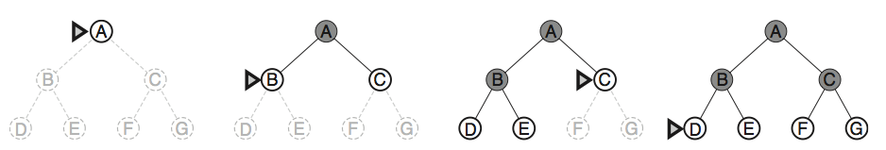
Breadth-first Search
Fringe stored as FIFO queue

Slide 4
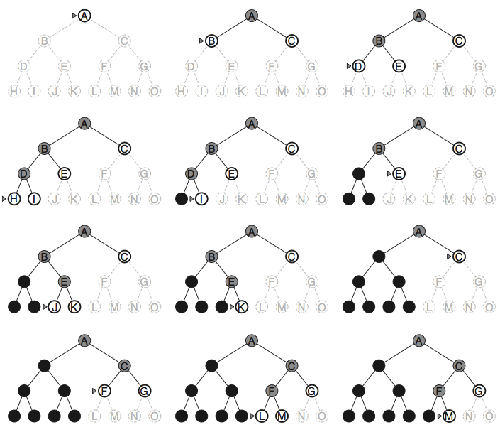
Depth-first Search
Fringe stored as
LIFO stack

Slide 5
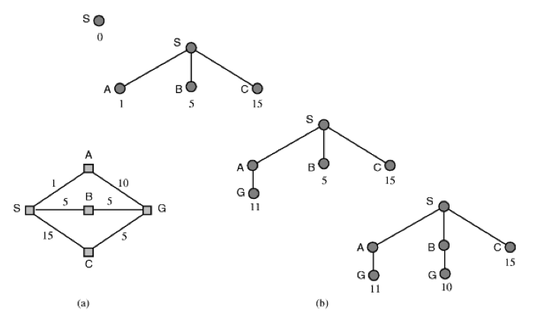
Uniform-cost Search
Fringe stored as
a priority queue
where priorities are defined based on the
minimum
“g: cost-from-start”

Slide 6
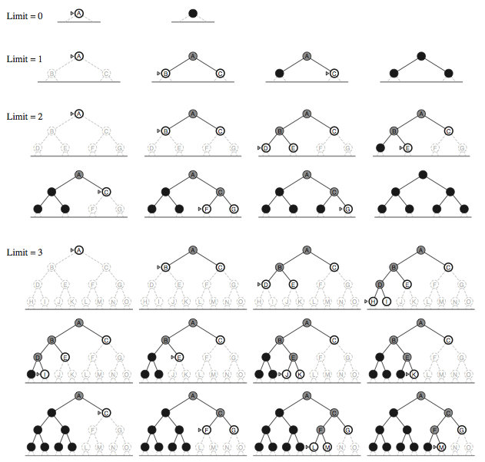
Iterative-Deepening Search

Slide 7
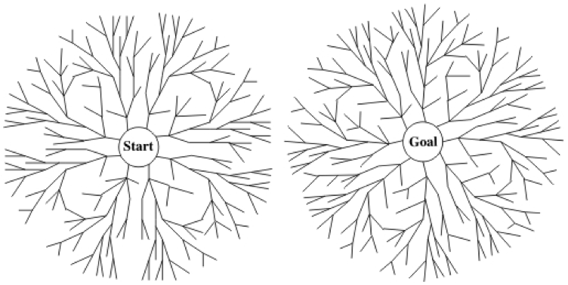
Bidirectional Search

Slide 8
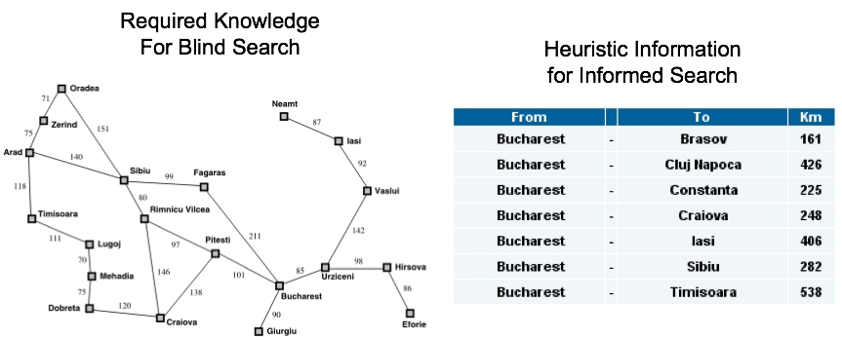
Informed Search
So far the techniques made use only of information that could be stored on a graph, i.e., the successor function
282
538
Often, however, we have available problem-specific knowledge that can help.
When additional information is used... we talk about “Informed Search”.
How can we take advantage of such additional information?

Slide 9
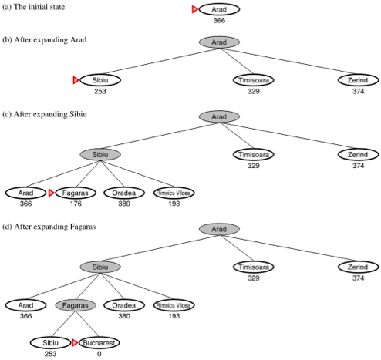
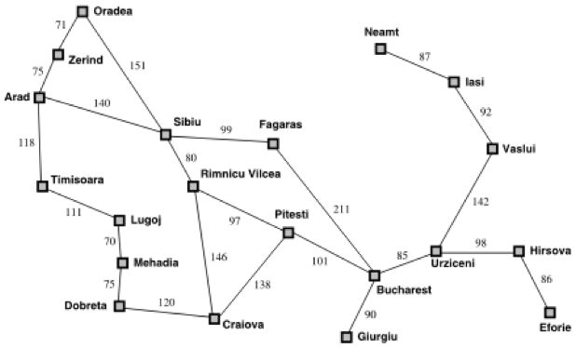
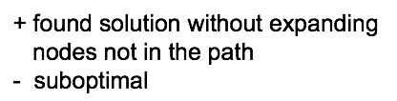
Greedy Best-First Search
Best-first Search: Optimize an evaluation function f: X →R
Heuristic: h(n)
estimated cost of the optimum path from n
Greedy Approach
f(n) = h(n)

Slide 10

Greedy Best-First Search
Select the node from the fringe that optimizes an evaluation function f(n)
Implementation:
Priority queue (e.g., binary heap)
Heuristic function:
h(n): estimated cost of the cheapest path from node n to a goal node
computable for all states
h(n) = 0, iff n is a goal state
Greedy BFS:
Expand the node closer to the goal according to the heuristic: f(n) = h(n)

Slide 11
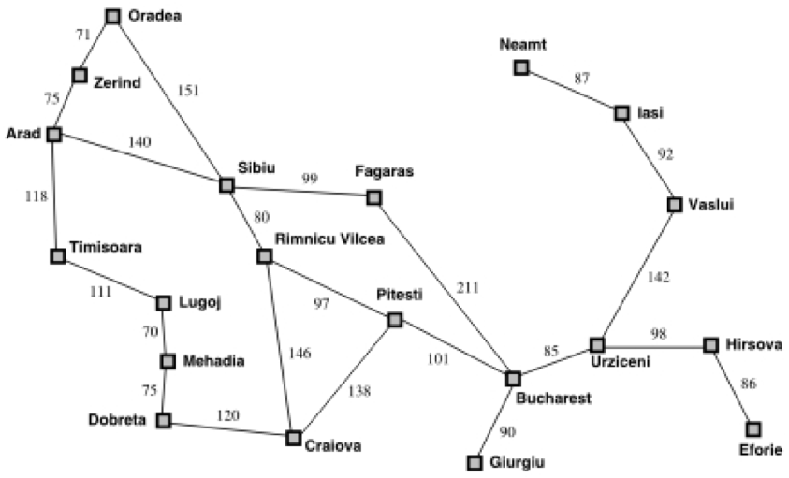
From Iasi to Fagaras

Slide 12
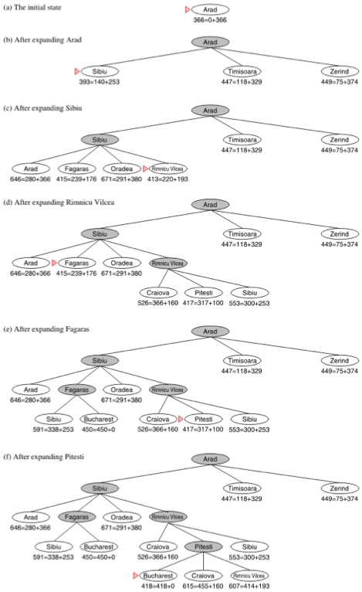
A*
Objective:
Minimize the total estimated solution cost: f(n) = g(n) + h(n)
g(n): cost from start to the goal
Case 1: TREE-SEARCH
(allow repeated states)
If h(n) admissible
then A* is optimal
Admissible = Optimistic
Never overestimate the cost to goal
e.g., straight-line distance between cities on a map, Manhattan distance in grids, etc.

Slide 13
A*
Case 2: GRAPH-SEARCH
(avoid repeated states)
Admissibility is not sufficient.
2 solutions to retain optimality:
once you found a repeated state, discard the more expensive path (extra book-keeping, expensive)
make sure the first path followed to a repeated state is optimal
If h(n) is consistent then A* is optimal
Admissible = Monotonic
Satisfies the triangular inequality

